Slide 2
Introduction
Marcus

Slide 3
Why DDP
Collaboration
Transparency
Marcus

Slide 4


Why Documentation Driven Programming?
Accuracy Reusability
Bug image from http://www.flickr.com/photos/fastjack/282707058/

Slide 5
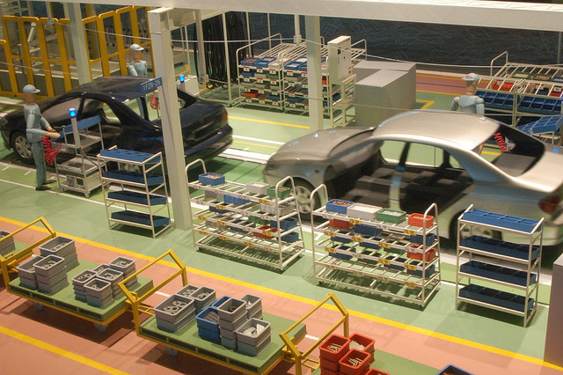
Modular Programming

Slide 6
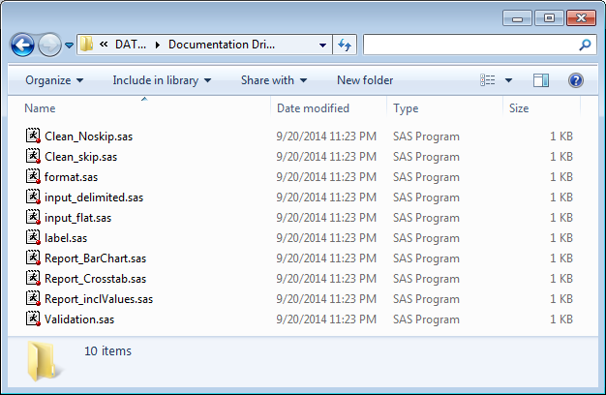
DDP Example Modules

Slide 7
Control File
Marcus

Slide 8
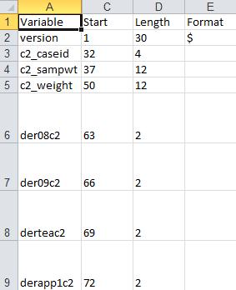
Input

Slide 9
Input (cont’d)
Constructing statements like:
@[start] variable [informat][length]
These become macro parameters
%macro read_in(var,start,fmt,length);
@&start. &var. &fmt.&length.
%mend;

Slide 10
Macro Variable Lists
Turn data into macro calls
proc sql noprint;
select cats('%read_in(',variable,',',start,',',format,',',length,')')
into :read_in_flat separated by ' '
from prepped_control
where start ne ' ';
quit;
Creates calls like this
%read_in(version,1,$,30.)
%read_in(c2_caseid,32,,4.)
%read_in(c2_sampwt,37,,12.)

Slide 11
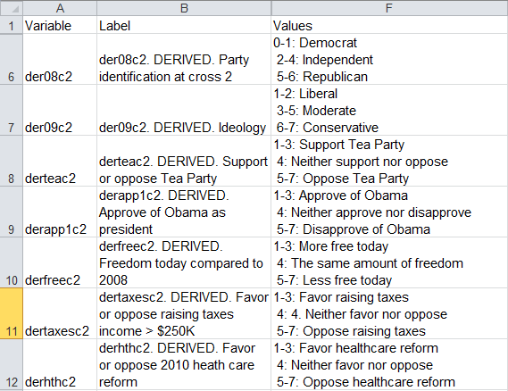
Formats and Labels: In Same Sheet
Labels are applied as SAS labels
Formats are defined with ranges left of colon and value labels right of colon

Slide 12
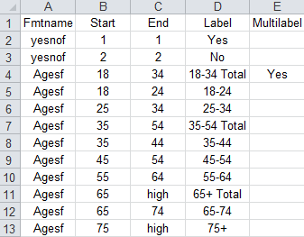
Formatting: Separate Sheet
Include Variable Labels in main tab

Slide 13
Format Import
data format_cntlin;
set format_control_vert;
format start end label $64.;
start=scan(scan(col1,1,':'),1,'-');
end=ifc(find(col1,‘-')>0, scan(scan(col1,1,':'),2,'-'),start);
label=strip(scan(col1,2,':'));
label_sas = tranwrd(strip(label),' ','_');
run;
proc format cntlin=format_cntlin;
quit;

Slide 14
Validation
Marcus

Slide 15
Cleaning
Marcus

Slide 16
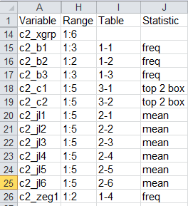
Reporting
Define Tables (Reports)
Define Statistic for calculation
Range defines valid values for reporting

Slide 17
Report Calculation Macro (part 1)
%macro tab_prop(var,fmt,table);
proc tabulate data=cleaned_data out=_table_&table.(rename=&var.=stub);
class &var. &class./mlf missing;
var weight_inv;
table (&var.*colpctn weight_inv*sum),(all &class.);
freq tabulateweight;
format &var. &fmt.;
label weight_inv='Total Respondents';
where not(missing(&var.));
run;

Slide 18
Report Calculation Macro (part 2)
data _table_&table. ;
format stub $256.;
set _table_&table.(where=(not(strip(columnvar)='.‘)));
array classes &class.;
do _i = 1 to dim(classes);
if substr(_type_,_i+1,1)='1' then columnvar=classes[_i];
end;
if (substr(_type_,1,1)='1' and length(compress(_type_,'0'))=1) or compress(_type_,'0')=' ' then columnvar='All';
Score=round(coalesce(of pct:,weight_inv_Sum),1.0);
Stattype=ifc(not(missing(weight_inv_Sum)),
'Total Respondents', 'Percent');
Table="&table.";
if stattype='Total Respondents' then stub=vlabel(stub);
keep table stattype stub columnvar score;
run;
%mend;

Slide 19
Report Generation
Accumulate Calculation Datasets
Simple PROC REPORT defined by control file
%macro report(page);
proc report data=for_report nowd spanrows;
where substr(table,1,1)="&page.";
columns
(stub stattype)
(All &columnord.)
;
define stub/' ' display style={width=1.5in};
define stattype/' ' display;
define all/display;
&definecol.;
run;
%mend;

Slide 20
Reporting
Modular design encourages customization
Separate calculation from reporting
Simplifies devleopment
Additional enhancements
Common stylesheets/templates
Graphing/charting
Output destination selection

Slide 21
Conclusion
Marcus

Slide 22
Other things you can do
Joe/Both

